Slide 1
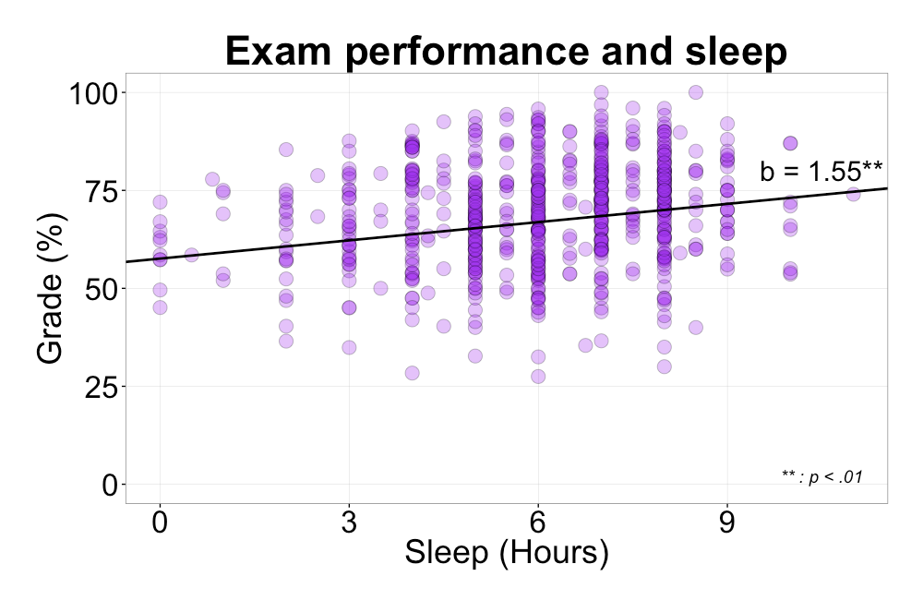
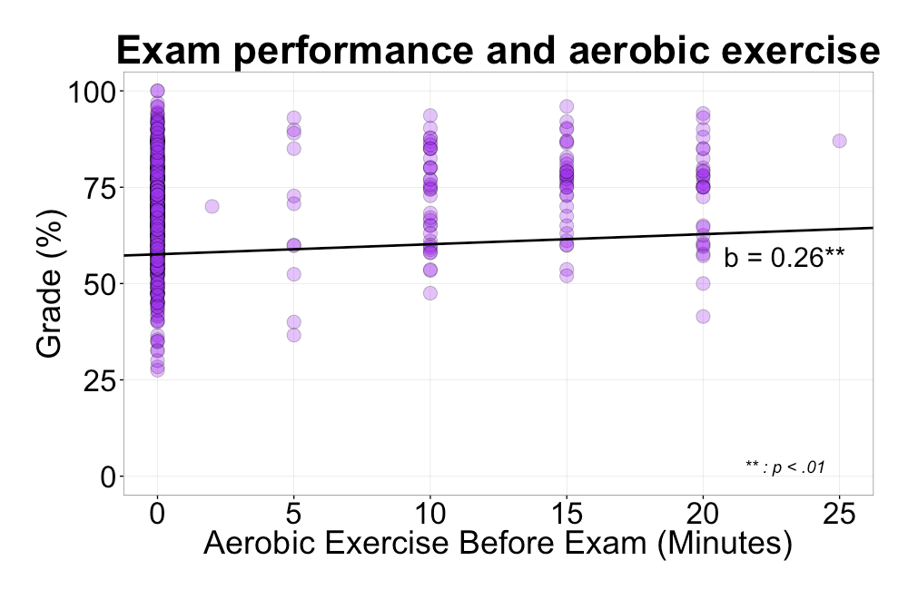
Lifestyle and cognition:
The relationship between sleep, exercise, and exam performance
Kyle Gooderham, Simon Ho, & Todd C. Handy
Department of Psychology, University of British Columbia
Background
Results
Discussion
Many studies have identified the benefits of behavioural lifestyle factors on cognitive performance
Research has shown improvements to attention, learning, problem solving, and memory in populations who followed exercise regimens over the course of many months
However, many of these experiments have been conducted in lab settings and have not examined these relationships in a naturalistic environment
Furthermore, little research has investigated the effect of recent lifestyle factors, such as sleep, on the relationship between exercise and cognition
Research Question: How does sleep and physical activity impact performance on an academic exam?
Exam performance was significantly related to the amount of sleep a participant had the night prior to the examination
Low intensity physical activity, such as stretching, was not predictive of exam score
However, the amount of aerobic exercise on the day of the exam is highly related to exam performance
The study highlights the importance of various lifestyle factors in predicting cognitive performance, and importantly that these effects can be seen in a naturalistic setting
Limitation: Students were nested within classes, therefore a more accurate model would be a multi-level model, this would allow us to capture the clustering effect of the class variable
Methods
N=? (? male, ? female; mean age = ?)
Administered a questionnaire to undergraduate classes immediately following their final examination
The questionnaire focused on lifestyle factors that may have impacted performance on the exam, and included control factors such as the time spent studying, sleep quality, and the amount of stretching
“How many hours of sleep did you get last night?”
“How much aerobic activity, in minutes, have you gotten today?”
Student scores on the exams were used in the regression analysis
References
Aretz, A. J., & Wickens, C. D. (1992). The mental rotation of map displays. Human Performance, 5(4), 303-328.
Bunch, R. L., & Lloyd, R. E. (2006). The cognitive load of geographic information. The Professional Geographer, 58(2), 209-220.
Williams, L. J. (1982). Cognitive load and the functional field of view. Human Factors: The Journal of the Human Factors and Ergonomics Society, 24(6), 683-692.
Cherney, I. D., Brabec, C. M., Runco, D. V. (2008). Mapping out spatial ability: sex differences in way-finding navigation. Perceptual and Motor Skills, 107(3), 747-760.
Significant relationship between sleep and exam performance; b = 1.55, .95CI [0.59, 2.55], t(641) = 2.69, p < .01
No significant relationship between the amount of stretching and exam performance; b = 0.22, .95CI [-0.51, 0.70], t(641) = 0.70, p = .48
Significant relationship between aerobic activity and exam performance; b = 0.26, .95CI [0.08, 0.43], t(641) = 2.72, p < .01
Correspondence regarding this poster should be addressed to:
Kyle Gooderham
kyle@psych.ubc.ca

